Slide 1

CAARTOONIFYING AN IMAGE USING MACHINE LEARNING
Name: Mohammad Aves
University roll no:2017515
Section/roll no: CST/13
Enrollment no: GE-202017515
Under the guidance of- Mr. Vikas Tripathi Sir

Slide 2
INTRODUCTION:
In this project, we will build one interesting application that will cartoonify the image provided to it. To build this cartoonifyer application we will use python and OpenCV. This is one of the exciting and thrilling applications of Machine Learning. While building this application we will also see how to use libraries like easygui, Tkinter, and all. Here you have to select the image and then the application will convert that image into its cartoon form. Mainly, we build this application using OpenCV and python as the programming languages.

Slide 3
REQUIREMENTS
Python: We use python as a programming language for building the application.
cv2: We use cv2 for image processing.
Numpy: Mainly NumPy is used for dealing with arrays. Here the images that we use are stored in the form of arrays. So for that, we use NumPy.
easygui: easygui is a module used for GUI programming in python. In our application easygui is used to open the file box to upload images from the local system.
Imageio: Imageio is a python library that reads and writes the images.
Matplotlib: Matplotlib is used for visualization purposes. Here we plot the images using matplotlib.
OS: Here in our application os is used for dealing with paths like reading images from the path and saving the image to the path.
Tkinter: Tkinter is a standard Graphical User Interface(GUI) package.

Slide 4
METHEDOLOGY: The methodology that we are going to follow to build our cartoonify application. First of all using easygui, we will upload the image, and then the image is converted to a greyscale image. The next two steps are the important steps to converting images into cartoon images. They are smoothening and then retrieving the edges. In this color of the image is smoothened to give the cartoon look and then we retrieve the edges and then highlight them in the final image. Next, we will prepare a mask Image. In this, we use the bilateral filter with removes the noise and smoothen it to some extent. Now the final step is giving the cartoon effect. To the image which we got in the previous step, we combine our two important steps and finally give a mask-edged image that looks like a cartoon image.

Slide 5
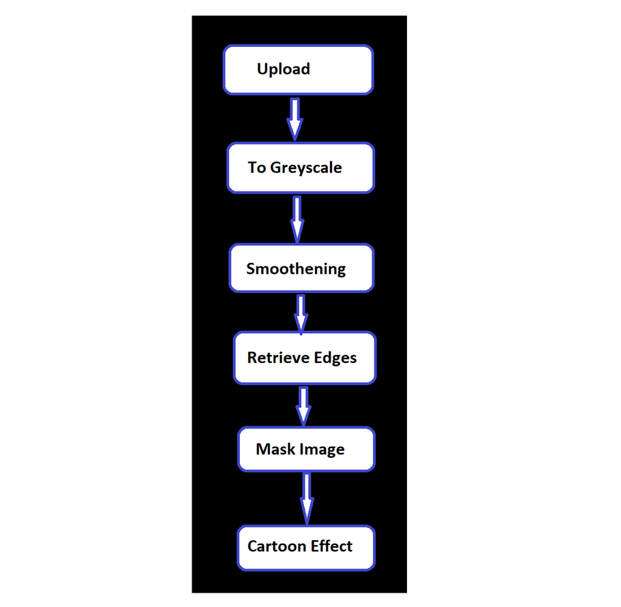

Slide 6
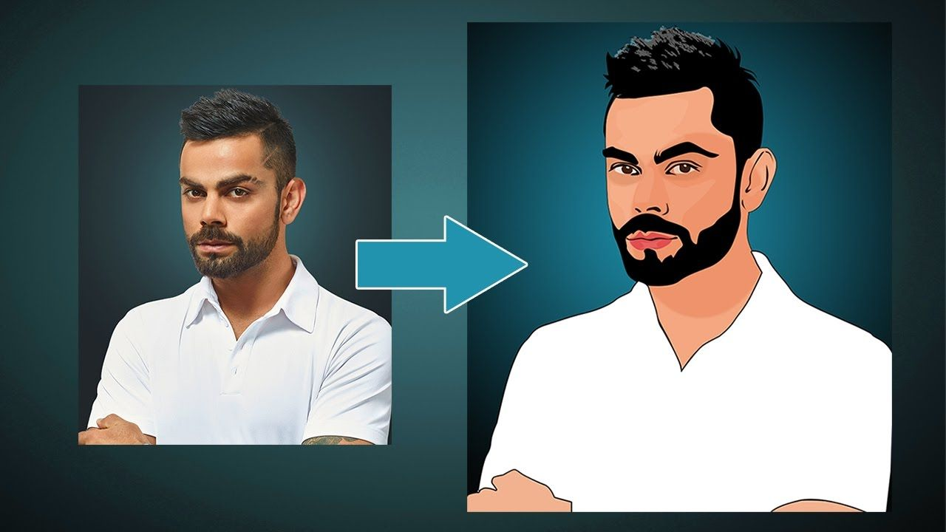
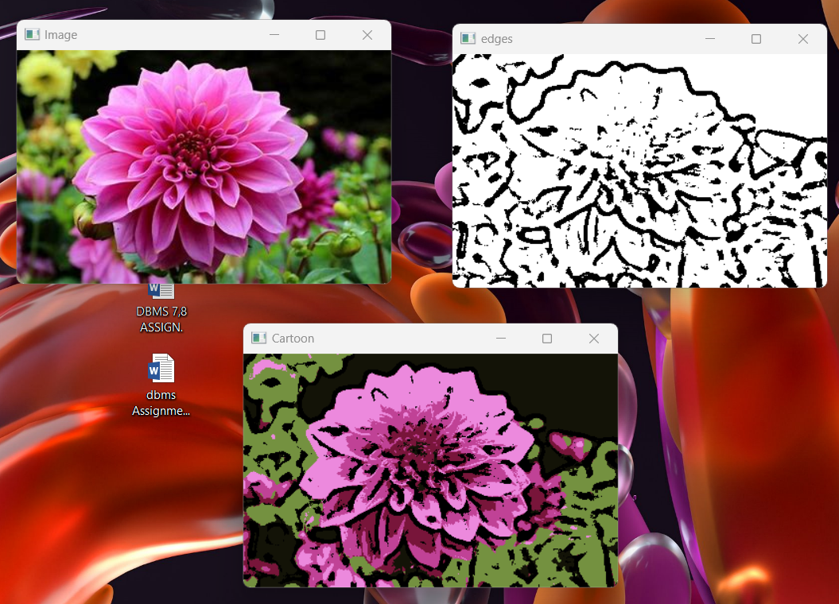
RESULTS AND DISCUSSION:
THIS IS MY CAARTOONIFIED IMAGE IN 3 TRANSITIONS:

Slide 7
CONCLUSION:
It includes origin and history of image processing , different types of uncertain environment , existing methos for cartoon imaging. An an example image processing is helpful to issue in signature recognisition , Digital video Processing , Remote sensing and finance . This paper is presented for an efficient method for extracted cartoon effects. The test result shows that the developed method could extract meaningful object will in different characters and backgrounds. This application aims to enables people with visual impartment to live more independently. Cartoonizing an image will transform an image into its cartoon image. It makes an image looks vicious and like water paint , removing the roughness in colours.

Slide 8
FUTURE WORK:
Currently the system is facing issues with face cartoonization. This can be improved by providing more facials data with different perspective to the model. The resolution of the output also need to be increased.

Slide 9
